Slide 1

307307 Part 3 – Introduction to Deep Learning and Large Language Models

Slide 2
Content
Introduction to Deep Neural Networks
CNNs
RNNs
The Transformer
Contextual Word Embeddings
Introduction BERT
Introduction to HuggingFace and the Transformers Library

Slide 3
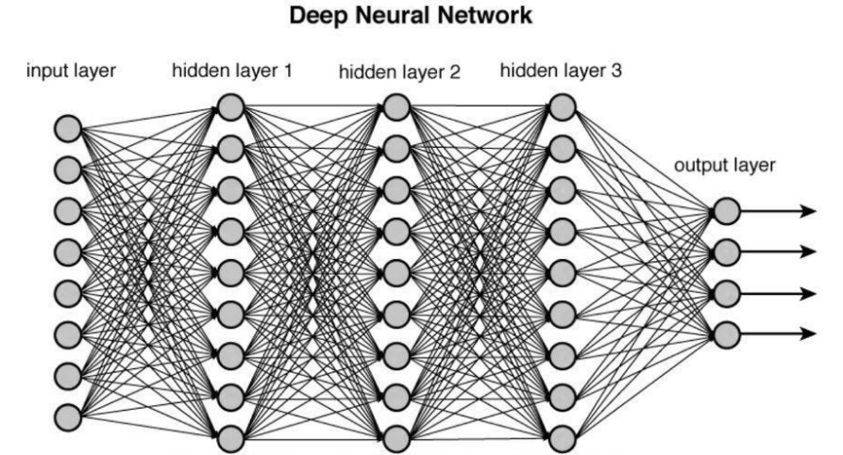
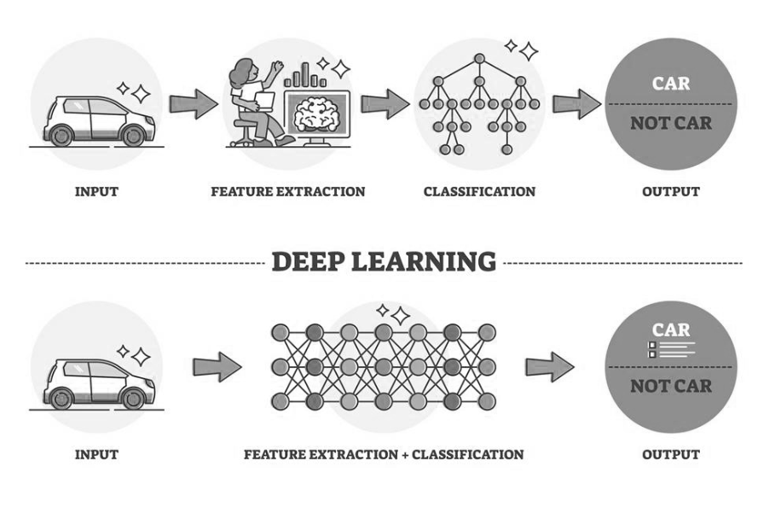
Introduction to Deep Learning
Neural Networks have revolutionized artificial intelligence by enabling machines to learn from data in ways that mimic human neural processes.
Deep neural networks (DNNs) are Neural Networks that are composed of multiple processing layers that can learn representations of data with multiple levels of abstraction.
The power of deep learning comes from its ability to automatically discover intricate patterns in raw data through the learning process, without requiring human engineers to manually specify all the knowledge needed by the computer system.

Slide 4
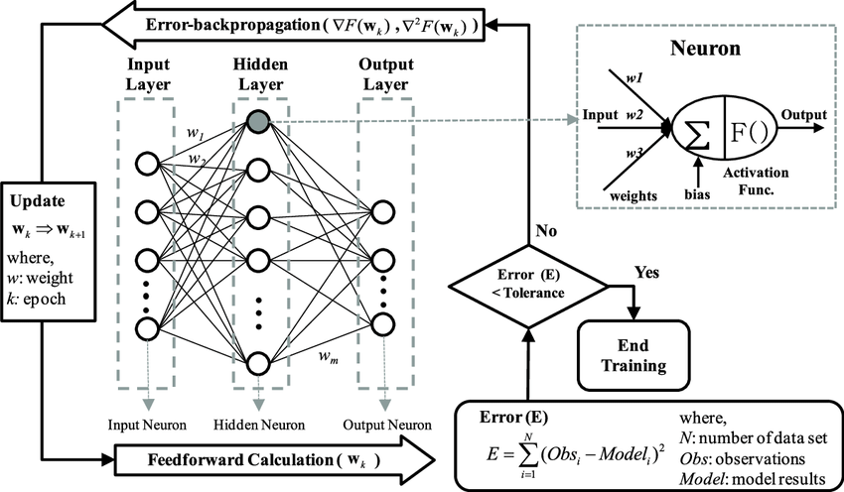
Introduction to Deep Learning
Fundamentals of Neural Networks
At their core, neural networks consist of:
Neurons: Mathematical functions that take inputs, apply weights, add a bias, and produce an output
Layers: Collections of neurons that process information in stages
Activation Functions: Non-linear functions that introduce complexity into the network
Weights and Biases: Parameters that are adjusted during training
The basic workflow involves:
Forward propagation: Data flows through the network
Loss calculation: The network's prediction is compared to the actual value
Backpropagation: Errors are propagated backward to update weights
Optimization: Weights are adjusted to minimize errors

Slide 5
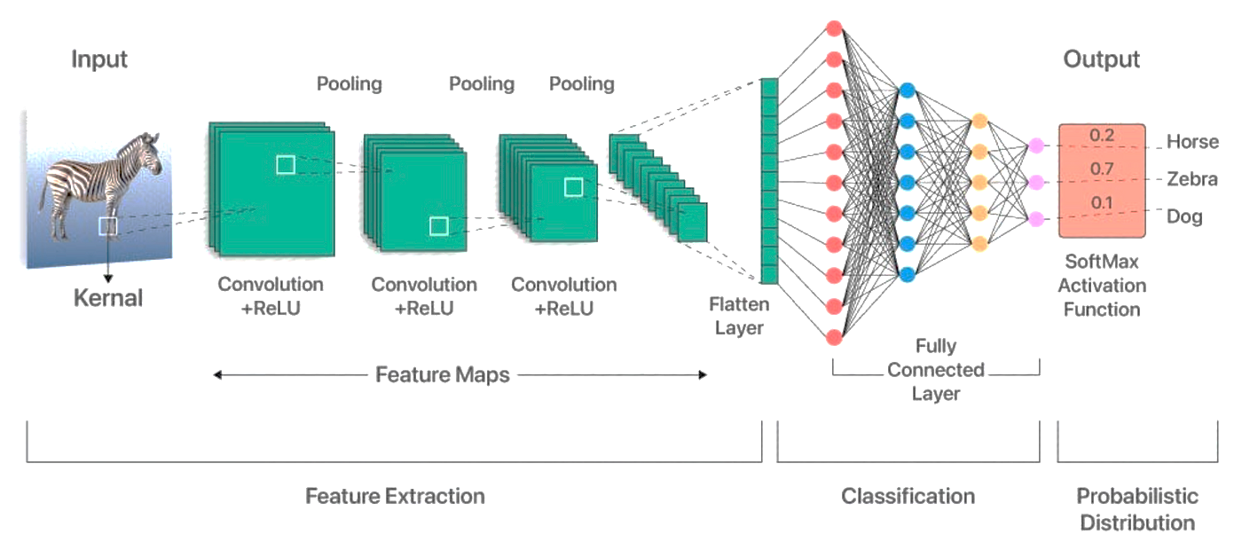
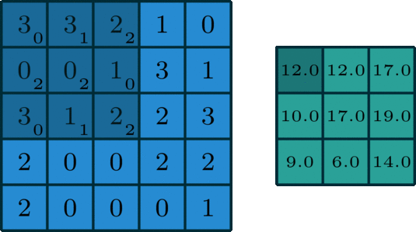
Convolutional Neural Networks
CNNs revolutionized image processing by introducing specialized layers that mimic how the visual cortex processes information.
Key components include:
Convolutional Layers: Apply filters that scan across the input data to detect patterns
Pooling Layers: Reduce dimensions while preserving important features
Fully Connected Layers: Connect every neuron to every neuron in adjacent layers
Instead of each neuron connecting to every pixel in an image (which would be computationally expensive), CNNs use:
Local connectivity: Neurons connect only to nearby pixels
Parameter sharing: The same filter is applied across the entire image
Business applications include:
Product image recognition
Visual quality control in manufacturing
Document processing
Customer behavior analysis in retail

Slide 6
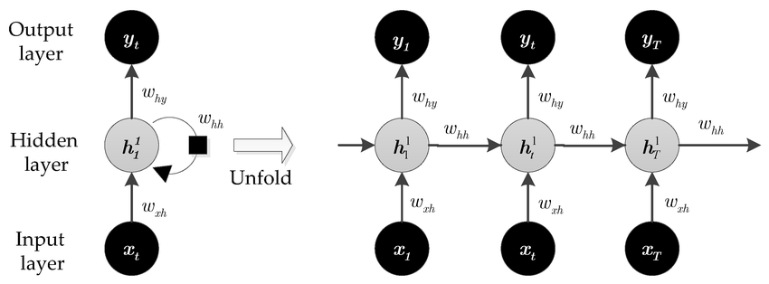
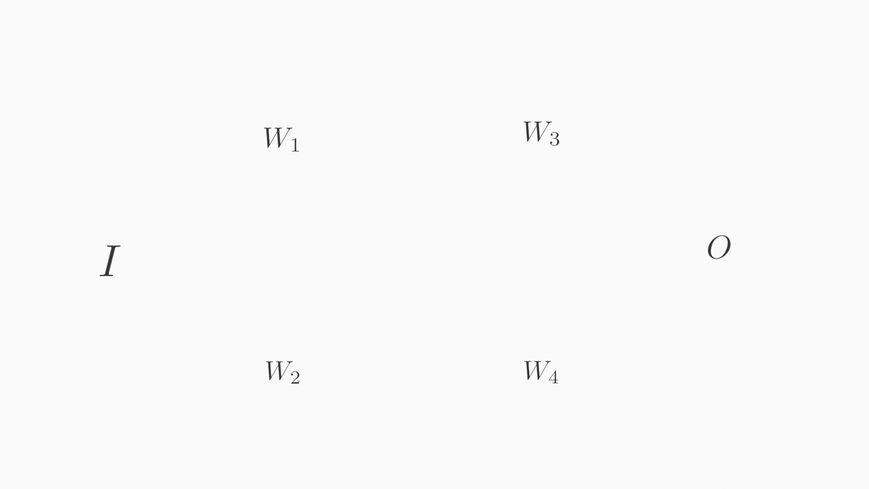
Recurrent Neural Networks (RNNs)
Unlike traditional neural networks, RNNs process sequences by maintaining a form of memory of previous inputs.
Key characteristics:
Time-dependent processing: Output depends on both current and previous inputs
Shared parameters: The same weights are applied at each time step
Memory: Internal state acts as a form of short-term memory
However, basic RNNs struggle with long-term dependencies due to:
Vanishing gradient problem: The influence of early inputs fades over time
Exploding gradient problem: Gradients grow uncontrollably during training
Business applications include:
Language Modeling & Text Generation – Predicting the next word in a sequence (e.g., autocomplete, chatbots).
Machine Translation – Translating text from one language to another.
Speech Recognition – Converting spoken language into written text.
Stock Price Prediction – Predicting future stock or financial data.
Weather Forecasting – Modeling temporal patterns in weather data.
Patient Monitoring – Analyzing sequences of medical data (e.g., ECG signals).
Music Generation – Creating sequences of musical notes.
Fraud Detection – Detecting unusual sequences in financial transactions.
Network Intrusion Detection – Monitoring patterns of activity over time.

Slide 7
Transformers

Slide 8

Transformers – Architecture and Principles
What is a Transformer?
A deep learning model based entirely on self-attention, with no recurrence or convolutions
Introduced in the paper “Attention Is All You Need” (Vaswani et al., 2017)
Transformer Components:
Embeddings: Convert tokens to vector representations
Positional Encoding: Adds position information
Multi-Head Attention: Processes relationships from multiple perspectives
Feed-Forward Networks: Process each position independently
Layer Normalization: Stabilizes training
Residual Connections: Helps with gradient flow
Architecture Variations:
Encoder-only (BERT): Good for understanding (classification, NER)
Decoder-only (GPT): Good for generation
Encoder-decoder (T5): Good for transformation tasks (translation, summarization)

Slide 9
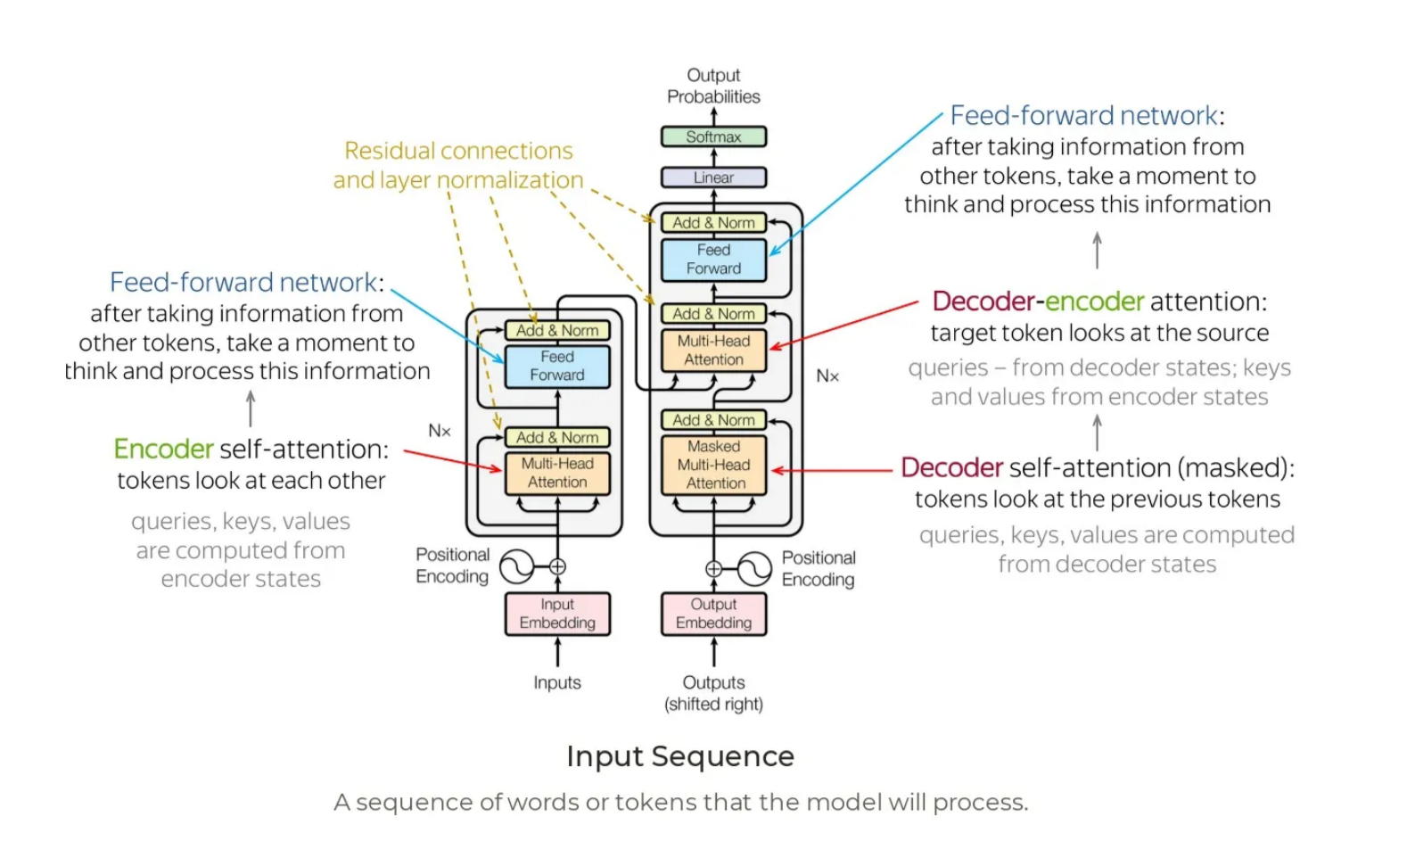
Transformers – Architecture and Principles

Slide 10
The Transformer in Detail
The transformer architecture is designed to process sequential data, such as natural language, in a highly efficient and effective manner.
Unlike traditional models that rely on sequential processing (like RNNs), transformers utilize a mechanism called self-attention, allowing them to analyze the entire input sequence at once.
This capability enables them to capture complex relationships and dependencies between tokens in the sequence.
The transformer model consists of two main parts:
1. Encoder: The encoder processes the input sequence and generates a continuous representation of it. This representation captures the contextual information of the input tokens.
2. Decoder: The decoder takes the encoder's output and generates the final output sequence. It does this by predicting one token at a time, using the encoded representations and previously generated tokens.
Both the encoder and decoder are composed of multiple identical layers—typically six layers in the original transformer architecture—allowing for deep learning and complex feature extraction.

Slide 11
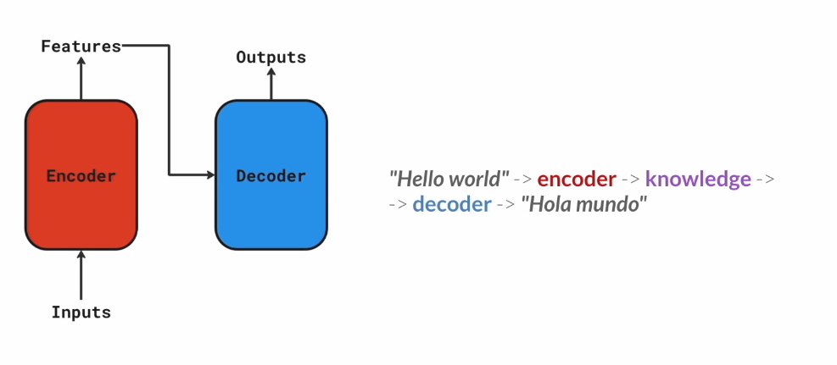
Transformer Architecture

Slide 12
Key Components of Transformers
Multi-Head Attention:
Function: Multi-head attention allows the model to focus on different parts of the input sequence simultaneously.
It computes attention scores for each token in relation to all other tokens, enabling the model to weigh the importance of each token when making predictions.
Mechanism: The attention mechanism uses three vectors: Query (Q), Key (K), and Value (V).
The attention scores are calculated as the dot product of the query and key vectors, scaled by the square root of the dimension of the key vectors.
These scores are then used to weight the value vectors, producing a context-aware representation of the input.
2. Feed-Forward Networks:
Function: Each layer of the encoder and decoder contains a feed-forward neural network that processes the output from the attention mechanism.
This network enhances the model's ability to learn complex representations.
Structure: The feed-forward network consists of two linear transformations with a non-linear activation function (usually ReLU) applied between them.
This allows the model to capture intricate patterns in the data.

Slide 13
Key Components of Transformers
3. Positional Encoding:
Purpose: Since transformers do not inherently understand the order of tokens, positional encodings are added to the input embeddings.
This encoding provides information about the position of each token within the sequence, allowing the model to consider the order of words.
Implementation: Positional encodings are typically generated using sine and cosine functions, which create unique encodings for each position that can be added to the input embeddings.
4. Layer Normalization:
Function: Layer normalization stabilizes the training process by normalizing the inputs to each layer.
This helps mitigate issues related to internal covariate shift and improves convergence during training.
Application: It is applied after the attention and feed-forward layers, ensuring that the outputs are centered and scaled appropriately.
5. Residual Connections:
Purpose: Residual connections help facilitate the flow of gradients during training, addressing the vanishing gradient problem.
They allow the model to learn more effectively by providing a direct path for gradients to flow through the network.
Implementation: The output of each sub-layer (attention and feed-forward) is added back to the original input, creating a shortcut that enhances learning.
The transformer architecture is a powerful and flexible model that has transformed the landscape of natural language processing and other fields. Its ability to process entire sequences simultaneously, leverage self-attention mechanisms, and utilize deep learning through stacked layers makes it a robust choice for a wide range of tasks.

Slide 14
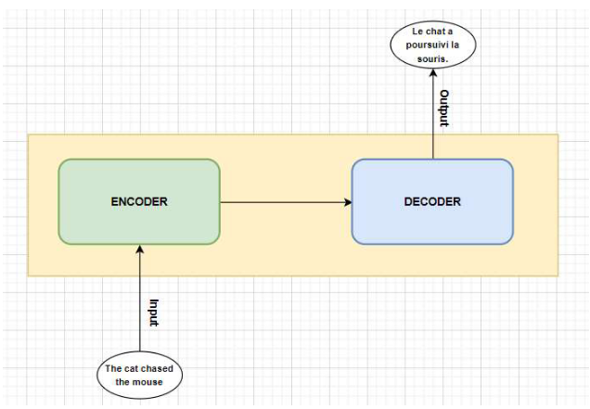
How Transformer Works
Let's understand how the transformer takes input, processes and gives output.
We will consider a simple example of translating an English sentence to French using a transformer model.
Suppose we have,
Input sentence: "Your cat is a lovely cat”
We want to translate this to French:
Output sentence: "Ton chat est un chat adorable.“
The transformer takes the input, translates, and gives the output.

Slide 15
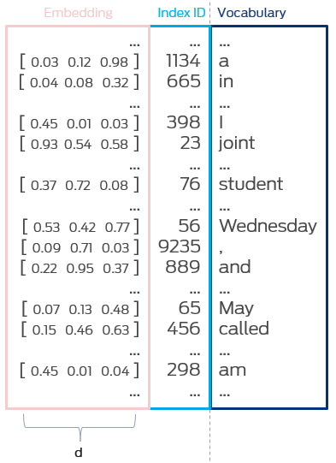
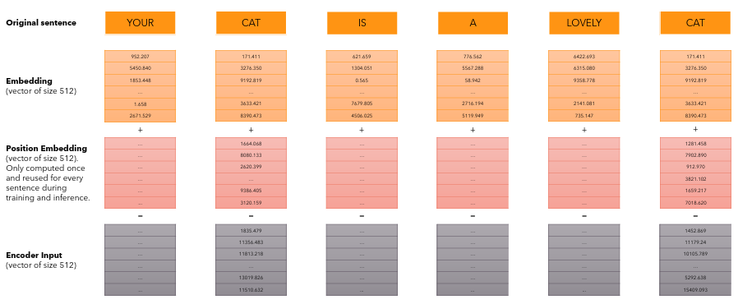
Input Preparation
English sentence (source):
“Your cat is a lovely cat“
Tokenization: Break the sentence into tokens: ["<s>", "Your", "cat", "is", "a", "lovely", "cat", "</s>"]
Embedding: Convert each token into a vector using a learned embedding matrix. These embeddings capture the semantic meaning of each word.
Positional Encoding: Add position-based information to each token embedding to provide information about the position of each token in the sequence. This is necessary because transformers process the entire sequence simultaneously, unlike RNNs that process one word at a time.
Without positional encoding, the self-attention mechanism would treat the sentence as a bag of words.

Slide 16
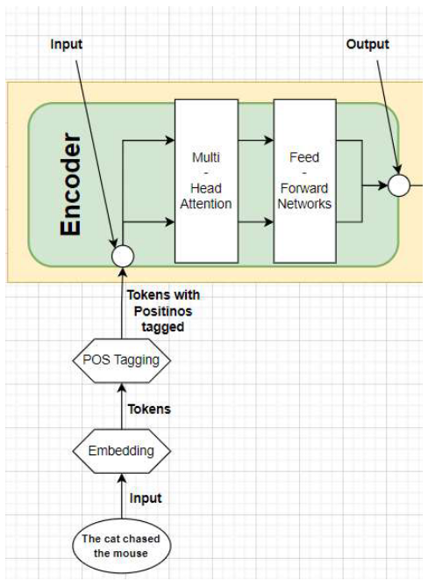
Encoder
The encoder processes the full input sequence in parallel through a stack of layers.
The encoder takes the input embeddings with positional encodings and passes them through multiple layers of multi-head attention and feed-forward networks. Each encoder layer processes the input, allowing the model to learn complex representations of the sentence.
For example, in a sentence like “The cat chased the mouse”, the attention mechanism in the encoder might learn that "cat" is related to "chased" and "mouse", capturing the semantic relationships between the tokens.
Each encoder layer includes:
Multi-head Self-Attention: Each word learns which other words to focus on. Example: The second occurrence of "cat" may attend to the first "cat" to recognize repetition or coreference.
Add & Norm: A residual connection followed by layer normalization.
Feedforward Network: A two-layer neural network processes each position independently.
Add & Norm: Another residual connection and normalization.
This stack is repeated several times (e.g., 6 layers), producing a set of contextualized vectors, one for each token.

Slide 17
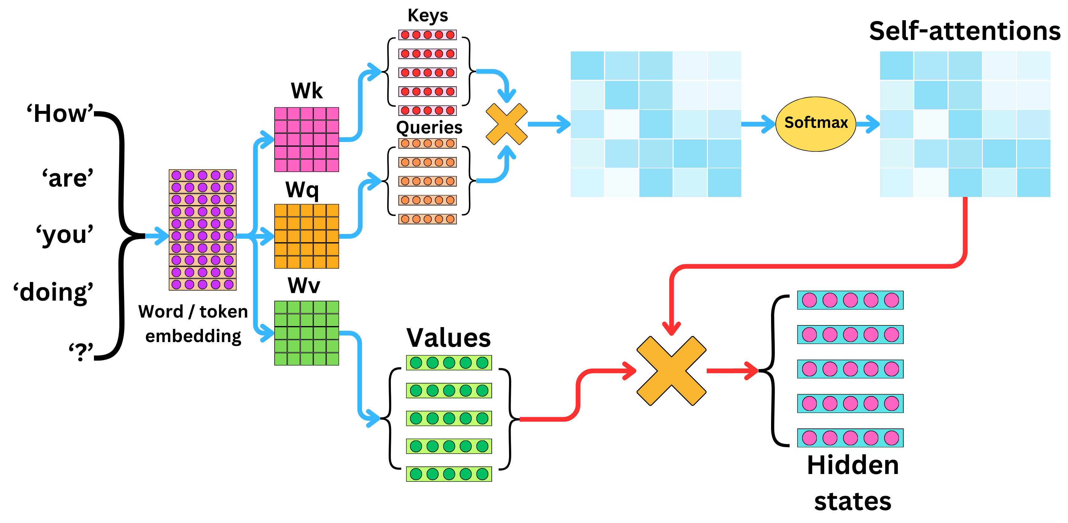
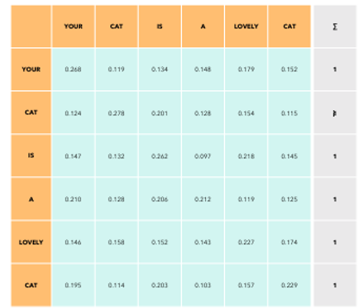

The Attention Mechanism
Create Q, K, V matrices: Each word embedding is multiplied by three learned weight matrices (WQ, WK, WV) to create Query, Key, and Value representations:
Q = X · WQ
K = X · WK
V = X · WV
Compute attention scores: Each query vector is dot-producted with all key vectors to get raw attention scores:
Scores = Q · K^T
Scale the scores: Divide by √dk (where dk is the dimension of the key vectors) to prevent the values from getting too large:
Scaled scores = (Q · K^T) / √dk
Apply softmax: Convert the scaled scores to probabilities:
Attention weights = softmax(Scaled scores)
Compute weighted values: Multiply the attention weights by the value vectors:
Output = Attention weights · V
So the formula is: Attention(Q,K,V) = softmax((Q·K^T)/√dk) · V

Slide 18
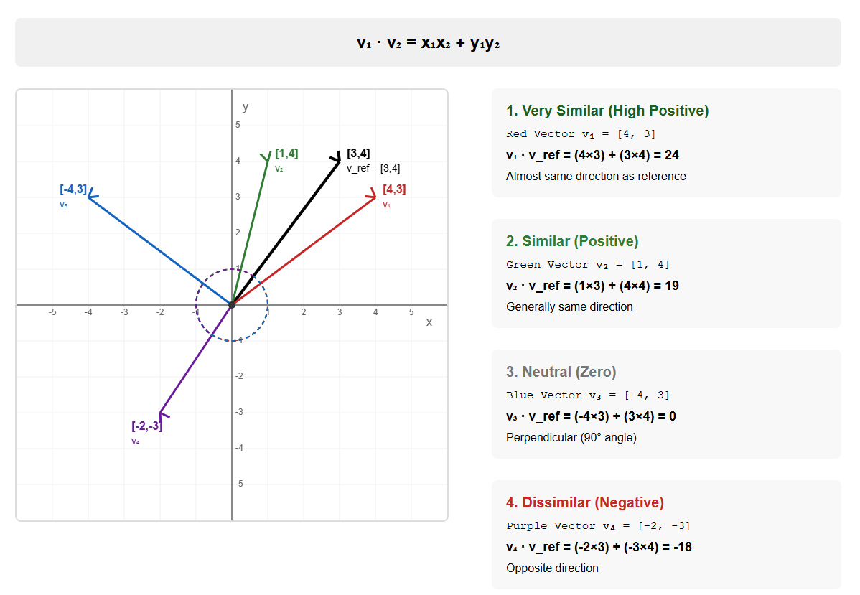
Vector Dot Product as Similarity Measure

Slide 19
Key Innovation: Self-Attention Mechanism
Self-attention allows each word to compute its embedding by gathering information from all other words in the sequence.
The "attention weights" determine how much each word should focus on other words.
Words that are semantically related tend to have higher attention scores between them.
This mechanism helps capture long-range dependencies and relationships regardless of word distance.
Multiple attention heads in parallel (Multi-head Attention) allow the model to focus on different aspects of relationships.

Slide 20
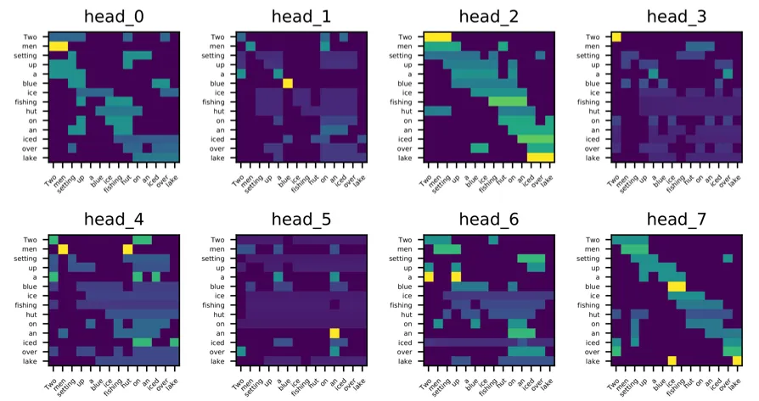
Multiple Attention Heads
Multiple attention heads in parallel (Multi-head Attention) allow the model to focus on different aspects of relationships.
For example, one head might learn which words are related by grammar, while another might focus on semantic meaning.
This allows the model to capture a richer and more comprehensive understanding of the input.

Slide 21
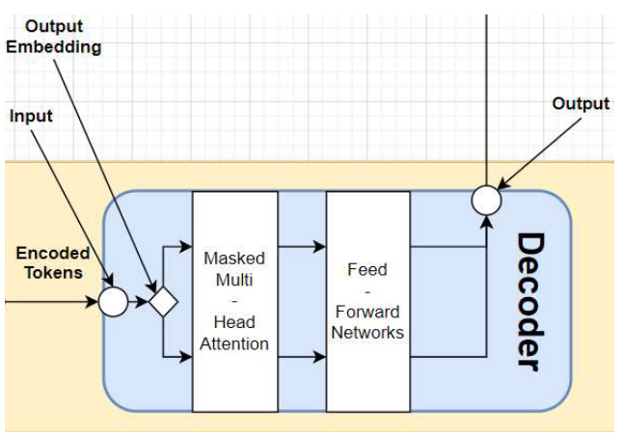
Decoding Process
The decoder takes the encoder's output and generates the output sequence in French.
It uses masked multi-head attention to ensure that predictions for a given token do not depend on future tokens.
This allows the decoder to generate the output one token at a time.
The decoder also attends to the encoder's output, enabling it to incorporate context from the input sentence while generating the translation.
For instance, the attention mechanism in the decoder might focus on the representation of "cat" when generating "Le chat", ensuring that the translation is consistent with the input.

Slide 22
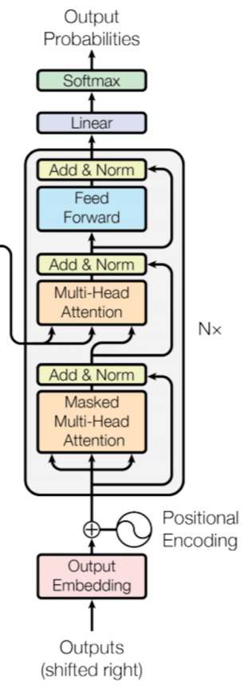
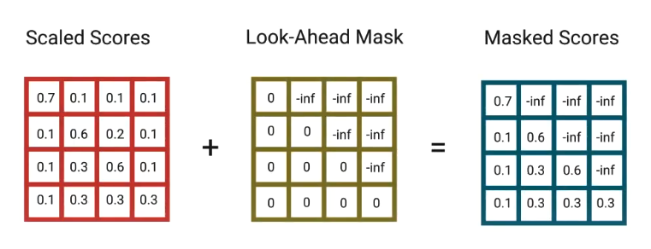
Decoder Components
Masked Multi-head Self-Attention: Looks at the previously generated French words. Future words are masked to prevent cheating.
2. Encoder-Decoder Attention: Each decoder token can attend to all encoder outputs. Example: The decoder token "chat" may attend to the English "cat" to align the translation.
3. Feedforward Network: Processes each token vector separately.
Also, each sub-layer includes residual connections and layer normalization.

Slide 23
Decoder Training and Inference
Training Phase:
The decoder begins with a special start-of-sequence token <s>
At each time step, it receives the actual previous target words.
Example: Step 1: <s>, Step 2: <s> Ton, Step 3: <s> Ton chat, etc.
Inference Phase:
Starts with <s> and generates one word at a time.
Each new word is used as input for the next step.
Example: <s> → Ton → chat → est → ...
Summary: By combining attention to past outputs and the encoded input, the decoder generates coherent, context-aware text—essential for tasks like translation and summarization.

Slide 24
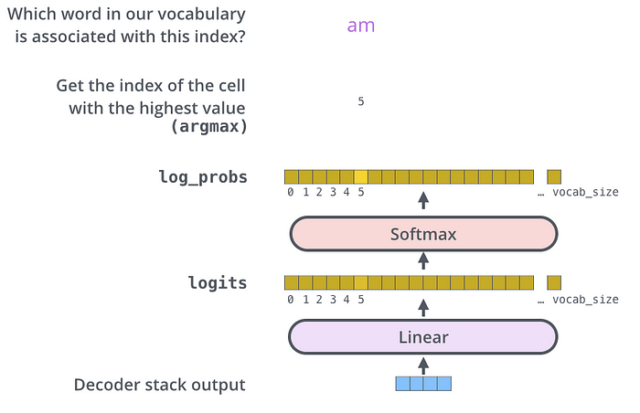
Output Generation
The decoder outputs a vector at each time step.
A linear layer followed by softmax turns this vector into a probability distribution over the French vocabulary.
The model selects the most probable next word ("Ton", then "chat", then "est", etc.).
This continues until an end-of-sentence token </s> is generated or a length limit is reached.

Slide 25
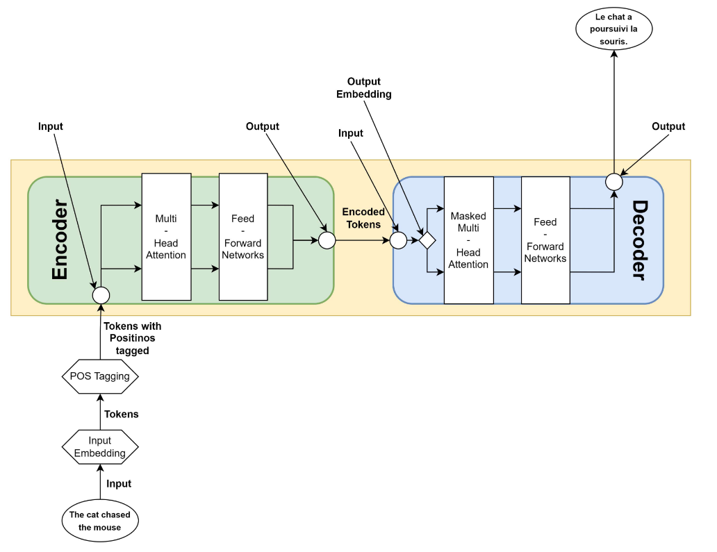
A Summary of how the Transformer Works
Input Sentence: "The cat chased the mouse."
Input Encoding:
Break down the sentence into tokens (words).
Convert each token into a numerical representation called an embedding.
Add positional encodings to the embeddings to provide information about the position of each token.
Encoder Processing:
The encoder takes the input embeddings with positional encodings.
Pass the input through multiple layers of multi-head attention and feed-forward networks.
Each encoder layer processes the input, allowing the model to learn complex representations of the sentence.
The attention mechanism in the encoder learns relationships between tokens (e.g., "cat" is related to "chased" and "mouse").
Decoder Processing:
The decoder takes the encoder’s output.
Use masked multi-head attention to generate the output one token at a time.
Attend to the encoder’s output to incorporate context from the input sentence while generating the translation.
The attention mechanism in the decoder focuses on relevant parts of the input (e.g., the representation of "cat" when generating "Le chat").
Output Generation:
The decoder generates the output sequence token by token.
For the example, it generates: “Le”, “chat”, “a”, “poursuivi”, “la”, and “souris”.
The complete French translation is: “Le chat a poursuivi la souris.”
Key Advantages:
Process the entire input sequence simultaneously.
Use attention mechanisms to capture relationships between tokens.
Efficiently translates sentences, even with long-range dependencies.

Slide 26
Number of Parameters - Original Transformer Model
Component | Parameter | Formula / Size | Total Parameters
Input | Token embedding | Vocab_Size × d_model = 37000 × 512 | ≈ 18.94M
 | Positional encoding (fixed) | n × d_model | Not learned (original paper used fixed)
Attention (per layer) | Q/K/V weights per head | 3 × d_model × d_k = 3 × 512 × 64 | 98,304
 | Output projection | d_model × d_model = 512 × 512 | 262,144
 | Total per Multi-Head block | – | ≈ 360K
Feed-Forward (per layer) | Linear 1: 512 × 2048 | – | 1,048,576
 | Linear 2: 2048 × 512 | – | 1,048,576
 | Total FFN per layer | – | ≈ 2.10M
LayerNorm | 2 × γ, β per layer | 2 × d_model = 2 × 512 | 1,024
Encoder Block Total | – | Attention + FFN + LayerNorm | ≈ 2.46M
Encoder Total (6 layers) | – | 6 × 2.46M | ≈ 14.76M
Decoder Total (6 layers) | Similar structure + cross attention | ≈ 2.6M per layer | ≈ 15.6M
Output Layer | d_model × Vocab_Size = 512 × 37000 | tied/shared with embedding | ≈ 18.94M
Total Model Parameters | – | Encoder + Decoder + Embedding + Output | ≈ 65M

Slide 27
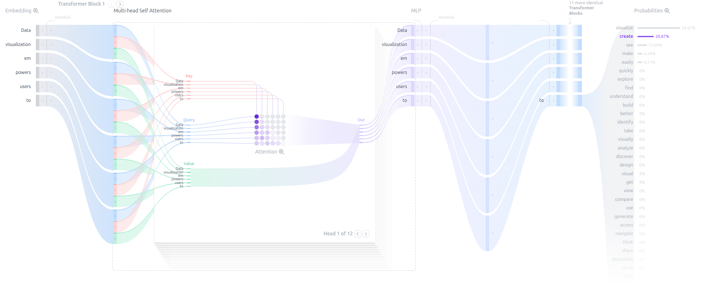
Transformer Explainer
https://poloclub.github.io/transformer-explainer/

Slide 28
References
https://jalammar.github.io/illustrated-transformer/
https://tamoghnasaha-22.medium.com/transformers-illustrated-5c9205a6c70f

Slide 29
Context Aware Embeddings

Slide 30
Contextual Word Embeddings (BERT and GPT)
Key Innovation
Unlike static embeddings (Word2Vec, GloVe), contextual models generate different vectors for the same word depending on its context.
Approach
Uses deep, pre-trained neural networks (often transformer-based)
Embeddings are derived from entire sentences, capturing syntax and semantics dynamically
Examples
BERT - Bidirectional Encoder Representations from Transformers (2018): Transformer-based neural networks trained with masked language modeling and next sentence prediction
GPT - Generative Pre-training Transformer (2018): Transformer-based unidirectional language model focused on generation.
Characteristics
Embeddings are context-sensitive (e.g., “bank” in “river bank” vs. “savings bank”)
Each word is embedded based on its role in the sentence.
Embeddings vary for the same word depending on its position and meaning.
Significantly improve performance on downstream NLP tasks.

Slide 31
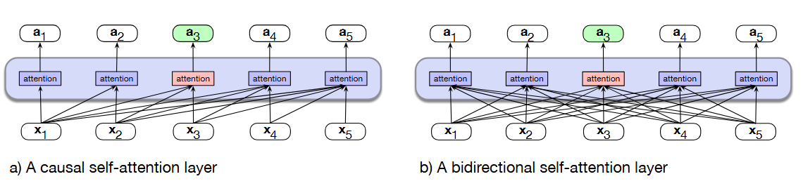
BERT: Bidirectional Encoder Representations from Transformers
Developed by Google in 2018
A pre-trained language model based on the Transformer encoder
Reads text bidirectionally, enabling deep contextual understanding
Key Ideas
Uses only the encoder stack of the Transformer
Pre-trained on large text corpora, then fine-tuned on specific tasks
Pretraining Objectives
Masked Language Modeling (MLM): Predict randomly masked words in a sentence
Next Sentence Prediction (NSP): Predict if one sentence follows another
Applications
Sentiment Analysis
Question Answering
Named Entity Recognition
Text Classification
Semantic Search

Slide 32
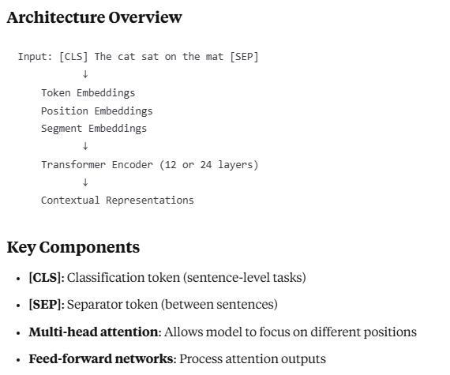
More About BERT
Key Advantages
Contextual embeddings: Word meanings change based on context
Captures long-range dependencies
Pre-trained on massive datasets → Transfer learning
State-of-the-art performance on 11 NLP tasks when released
How BERT Works:
Multiple stacked encoder layers with self-attention mechanisms
No decoders - purely focused on understanding input
Captures relationships between words and their context
Powerful context learning - understands word relationships in sentences
Meaningful representations - transforms text into useful numbers

Slide 33
BERT's Training Data
Pre-training Foundation
Training corpus: 3+ billion words
English Wikipedia
~10,000 unpublished books
Clean, large-scale dataset for comprehensive language learning
Pre-training approach to learn language patterns and context

Slide 34
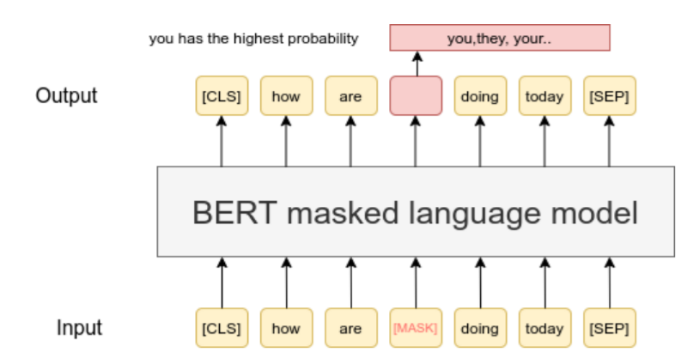
Training Objective 1 - Masked Language Modeling
Learning Through "Fill in the Blanks"
Random word masking: Some words are hidden during training
Context-based prediction: BERT predicts masked words using surrounding context
Example: "I love eating _____ in my fruit salad" → "lemons"
Key benefit: Learns word relationships and contextual understanding
Powerful concept: Used in many other AI applications

Slide 35
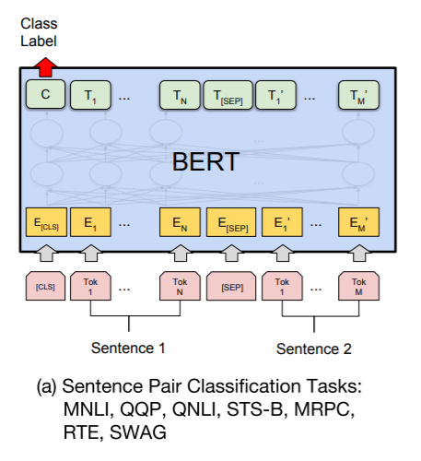
Training Objective 2 - Next Sentence Prediction
Title: Understanding Sentence Relationships
Sentence pair analysis: Given two sentences, determine if B follows A
Logical connection assessment: Analyzes context and content
Example:
A: "The cat climbed the tree"
B: "It was trying to catch a bird" ✓ (follows logically)
C: "The weather is nice today" ✗ (unrelated)
Note: Later removed in newer models (MLM proved sufficient)

Slide 36
BERT's Ideal Use Cases
Where BERT Excels
Text Classification: Sentiment analysis, topic classification, spam detection
Named Entity Recognition: Identifying people, organizations, locations, dates
Extractive Question Answering: Finding answers within provided context
Semantic Similarity: Measuring similarity between sentences/paragraphs
Key advantage: Perfect for understanding tasks, not generation

Slide 37
Extractive Question Answering Example
How BERT Answers Questions:
Process: Analyzes both context and question
Method: Identifies start and end tokens of the answer
Example:
Context: "Mount Everest is the highest mountain..."
Question: "What is the highest mountain?"
Answer: "Mount Everest" (extracted, not generated)
Important: BERT extracts existing text, doesn't generate new content

Slide 38
Component | BERT-Base (L=12, H=768, A=12) | BERT-Large (L=24, H=1024, A=16)
Embedding Layer - Token + Positional + Segment | 30522 × 768 + 512 × 768 + 2 × 768 ≈ 23.8M | 30522 × 1024 + 512 × 1024 + 2 × 1024≈ 31.4M
Self-Attention - Q/K/V + Output per layer | 4 × H² = 4 × 768² = 2.36M | 4 × 1024² = 4.19M
Total across all layers | 12 × 2.36M = 28.3M | 24 × 4.19M = 100.6M
Feedforward - Two linear layers per layer | 768 × 3072 + 3072 × 768 = 4.71M | 1024 × 4096 × 2 = 8.39M
Total across all layers | 12 × 4.71M = 56.5M | 24 × 8.39M = 201.4M
LayerNorms - Two per layer | 2 × 768 = 1.5K × 12 = 18K | 2 × 1024 × 24 = 49K
Pooler - Final CLS output to 768 or 1024 | 768 × 768 = 0.59M | 1024 × 1024 = 1.05M
Total Parameters | ≈ 110M | ≈ 340M
L: number of layers (Transformer blocks)
H: hidden size
A: number of attention heads (H / A = size per head)
Vocabulary size: 30,522
FFN hidden size: 4×H (3072 for base, 4096 for large)

Slide 39
BERT Variants
Common BERT Models
Model | Parameters | Layers | Hidden Size | Attention Heads
BERT-Base | 110M | 12 | 768 | 12
BERT-Large | 340M | 24 | 1024 | 16
DistilBERT | 66M | 6 | 768 | 12
RoBERTa | 355M | 24 | 1024 | 16
ALBERT | 12M-235M | 12-24 | 768-4096 | 12-64
Specialized Variants
BioBERT: Biomedical text
SciBERT: Scientific text
FinBERT: Financial text
ClinicalBERT: Clinical notes

Slide 40
Example: Print out BERT Embeddings
from transformers import BertTokenizer, BertModel
import torch
# Load pretrained BERT
tokenizer = BertTokenizer.from_pretrained('bert-base-uncased')
model = BertModel.from_pretrained('bert-base-uncased’)
# Sentence
sentence = "He went to the bank to deposit money.“
# Tokenize
inputs = tokenizer(sentence, return_tensors='pt’)
# Get outputs
with torch.no_grad(): # No training, just inference
outputs = model(**inputs)
# Get the hidden states (embeddings)
embeddings = outputs.last_hidden_state # Shape: (batch_size, sequence_length,
# (hidden_size)
print(embeddings.shape) # Example output: torch.Size([1, 11, 768])

Slide 41
GPT – Overview and Architecture
What is Generative Pre-trained Transformer (GPT)?
A family of Transformer-based language models developed by OpenAI
Uses only the decoder stack of the original Transformer architecture
Trained with causal (autoregressive) language modeling to predict the next token
Focuses on generating human-like text (unlike BERT's understanding focus)
Training Objective
Predict the next token in a sequence
GPT Variants
GPT-1 (2018, 120M Parameters): Introduced the pretrain-then-finetune paradigm
GPT-2 (2019, 1.5B Parameters): Scaled up model size, trained on web-scale data, Last publicly available weights
GPT-3 (2020, 175B Parameters): Enabled in-context learning, 100x boost, ~800GB file size
GPT-4 (2023, ~1T parameters (estimated)): Multimodal, stronger reasoning and generalization
Applications (Wide range of NLP tasks through text generation)
Text generation (e.g., chat, storytelling, code)
Summarization
Translation
Question answering
Semantic search and reasoning tasks

Slide 42
GPT's Architecture Deep Dive
How GPT Works
Multiple stacked decoder layers with self-attention mechanisms
No encoders - purely focused on text generation
Unidirectional processing - considers only left-side context
Next word prediction based on preceding words
High-quality text generation from learned context patterns
Contextual understanding combined with text creation capability

Slide 43
GPT Training Data
Pre-training Foundation
Massive, diverse datasets including:
Web pages
Books and articles
Billions of words total
Different datasets for each GPT version
Large-scale exposure to language patterns and context
Quality varies but emphasis on diversity and scale

Slide 44
Causal Language Modeling
GPT's Single Training Objective
Core task: Predict the next word in a sequence
Method: Uses context from preceding words only
Example: "I love drinking fresh ___" → "lemonade"
Key benefits:
Learns word relationships and context
Develops language patterns
Enables coherent text generation
Simplicity: No masked language modeling or next sentence prediction

Slide 45
GPT's Ideal Use Cases
Where GPT Excels
Text Generation: Story creation, creative writing, conversations
Instruction Following: Responding to prompts and commands
Translation: Converting text between languages
Summarization: Creating concise summaries of longer texts
Code Generation: Programming assistance and code completion
Versatile Applications: Any task involving text output

Slide 46
Number of Parameters – GPT 3
Component | Parameter | Formula / Size | Total Parameters (Approx.)
Embedding Layer | Token Embeddings | Vocab × d_model = 50K × 12288 | 614.4M
 | Positional Embeddings | n_ctx × d_model = 2048 × 12288 | 25.2M
Self-Attention (per layer) | Q, K, V, Output | 4 × d_model × d_model = 4 × 12288² | 604.6M per layer
Feedforward (per layer) | 2 layers (gelu) | d_model × d_ff + d_ff × d_model | 1.2B per layer
LayerNorms (per layer) | Two per layer | 2 × d_model | 24.6K per layer
Total per layer | – | Self-attn + FFN + norms | ≈ 1.8B per layer
Transformer Block Total | 96 × 1.8B | – | ≈ 172.8B
Final LayerNorm | – | d_model | 12.3K
Output Layer (tied) | Shared with token embedding | – | — (tied with input embedding)
Total Parameters | – | Sum of above | ≈ 175B
d_model = 12288
n_layers = 96
n_heads = 96 → each head has d_k = d_v = 128
d_ff = 4 × d_model = 49152
Vocabulary size ≈ 50,000
Sequence length (n_ctx) = 2048

Slide 47
GPT vs BERT Architecture
Aspect | GPT | BERT
Architecture | Decoder-only | Encoder-only
Text Processing | Unidirectional (left-to-right) | Bidirectional
Primary Goal | Text generation | Text understanding
Context | Previous words only | All surrounding words
Use Cases | Generation tasks | Classification/extraction

Slide 48
What is Hugging Face? 🤔
A company and a community platform focused on democratizing Artificial Intelligence, especially Natural Language Processing (NLP) and Machine Learning (ML).
Often called the "GitHub for Machine Learning."
Mission: To make state-of-the-art ML models, datasets, and tools accessible to everyone.
Started in 2016, initially with a chatbot app, then pivoted to open-source ML.
What does hugging face provide?
Accessibility: Provides easy access to thousands of pre-trained LLMs.
Standardization: Offers standardized tools and interfaces for working with different models.
Collaboration: Fosters a vibrant community for sharing models, datasets, and knowledge.
Innovation: Accelerates research and development in the LLM field.
Ease of Use: Simplifies complex ML workflows, from data preparation to model deployment.

Slide 49
Core Components of the Hugging Face Ecosystem
Hugging Face Hub:
The central place to find, share, and collaborate on models, datasets, and ML applications (Spaces).
Over 1.7 million models, 75,000+ datasets!
Transformers Library:
Python library providing thousands of pre-trained models for NLP, Computer Vision, Audio, and more.
Supports PyTorch, TensorFlow, and JAX.
Makes downloading, training, and using state-of-the-art models incredibly simple.
Datasets Library:
Efficiently load and process large datasets.
Optimized for speed and memory, built on Apache Arrow.
Access to a vast collection of public datasets.
Tokenizers Library:
Provides high-performance tokenizers crucial for preparing text data for LLMs.
Offers various tokenization algorithms and pre-trained tokenizers.

Slide 50
The Model Hub
Over 1,700,000+ Models Available
Popular Model Categories:
Text Generation: GPT, LLaMA, Mistral, CodeLlama
Text Classification: BERT, RoBERTa, DeBERTa
Question Answering: BERT-based models
Translation: T5, mT5, NLLB
Code Generation: CodeT5, StarCoder
Multimodal: CLIP, BLIP, LLaVA

Slide 51
Getting Started with Hugging Face
Explore the Hub: huggingface.co
Browse models, datasets, and Spaces.
Install Libraries:
pip install transformers datasets tokenizers accelerate gradio
Try a Pipeline:
# Example: Sentiment Analysis
from transformers import pipeline
classifier = pipeline("sentiment-analysis")
result = classifier("Hugging Face is awesome!")
print(result)
# Example: Text Generation
generator = pipeline("text-generation")
output = generator("In a world of large language models,", max_length=50)
print(output)
Under the Hood
Automatic model selection
Tokenization handled
Inference optimization
Result formatting
Device management
Traditional Approach
1. Load tokenizer
2. Preprocess text
3. Load model
4. Run inference
5. Post-process results
... 50+ lines of code

Slide 52
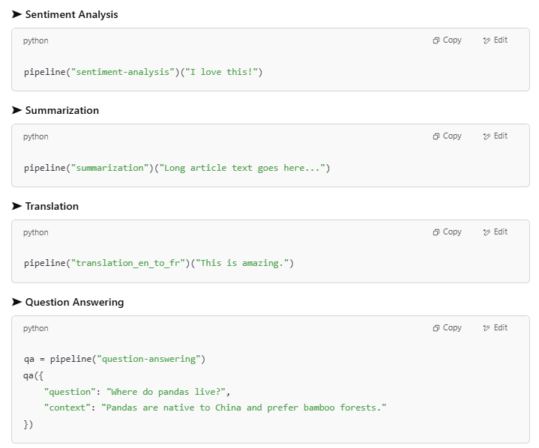
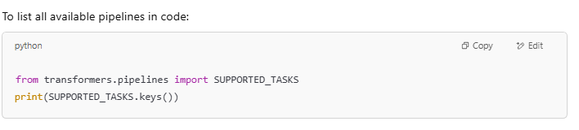
Other Hugging face Pipelines
Pipeline Name | Task Description
"sentiment-analysis" | Classify sentiment (positive/negative)
"text-classification" | General text classification (multi-label or multi-class)
"zero-shot-classification" | Classify into labels without training on them
"text-generation" | Generate text (e.g., GPT models)
"text2text-generation" | Text-to-text tasks (e.g., summarization, translation)
"translation" | Translate between languages
"summarization" | Generate a summary of input text
"question-answering" | Extract answer from context
"fill-mask" | Predict missing word in a sentence (BERT-style)
"ner" (Named Entity Recognition) | Extract entities (like names, places, etc.)
"conversational" | Chatbot-style conversation
"sentence-similarity" | Measure similarity between two sentences
"token-classification" | Classify each token (used for NER, POS tagging, etc.)
"feature-extraction" | Extract embeddings/features from a model
"table-question-answering" | QA over structured data (tables)

Slide 53
Training LLMs

Slide 54
What is LLM Training?
LLM Training is the process of teaching a neural network to understand, generate, and manipulate human language.
It involves feeding the model vast amounts of text data.
The model learns patterns, grammar, context, and even some level of "knowledge" from this data.
The goal is to adjust the model's internal parameters (weights and biases) to perform specific language tasks effectively.
Modern models have BILLIONS of parameters (numbers) to learn during the training process.

Slide 55
Essential Components of LLM Training
Dataset: Large corpus of text data (e.g., books, articles, websites). Quality, quantity, and diversity are crucial.
Model Architecture: The neural network structure, predominantly the Transformer architecture (with self-attention mechanisms).
Loss Function: A function that measures the difference between the model's predictions and the actual target values (e.g., cross-entropy for next-word prediction).
Optimizer: An algorithm that updates the model's parameters to minimize the loss function (e.g., Adam, SGD).

Slide 56
The General Training Loop
Data Preparation: Collecting, cleaning, and tokenizing the text data into a format the model can understand.
Model Initialization: Setting initial random values for the model's parameters.
Forward Pass: Feeding input data through the model to get predictions.
Loss Calculation: Comparing predictions to the actual data to quantify error using the loss function.
Backward Pass (Backpropagation): Calculating gradients, which indicate how each parameter contributed to the error.
Parameter Update: Adjusting model parameters using the optimizer in the direction that reduces the loss.
Iteration: Repeating steps 3-6 for many batches of data over multiple epochs (passes through the entire dataset).

Slide 57
Main Training Phases
LLM Pretraining.
LLM Fine Tuning

Slide 58
Pre-training: Building the Foundation
The initial, most resource-intensive training phase.
Models are trained on massive, diverse datasets (e.g., Common Crawl, Wikipedia, books).
The objective of this step is to learn general language understanding, grammar, common sense reasoning, and factual knowledge.
Usually self-supervised (e.g., predicting masked words, next sentence prediction).
Results in a base model with broad capabilities.
Examples: GPT-3, BERT, Llama pre-training.

Slide 59
Fine-tuning: Specializing the Model
Takes a pre-trained base model and further trains it on a smaller, task-specific dataset.
The objective of this step is to adapt the general knowledge of the pre-trained model to perform well on a particular downstream task (e.g., medical question answering, legal document summarization).
It requires significantly less data and computation than pre-training.
Can also be used for instruction tuning (following prompts) or aligning with human preferences (RLHF).

Slide 60
Data: The Critical Ingredient
Quantity: LLMs require vast amounts of text to learn effectively. "More data is better" is often true, up to a point.
Quality: Clean, well-formatted, and coherent data leads to better models. Garbage in, garbage out.
Diversity: Exposure to various styles, domains, and perspectives helps create more robust and less biased models.
Preprocessing:
Tokenization: Breaking text into smaller units (words, sub-words).
Normalization: Standardizing text (e.g., lowercasing, removing special characters).
Creating input IDs, attention masks.

Slide 61
Model Architecture: The Transformer
The dominant architecture for state-of-the-art LLMs.
Key Innovations:
Self-Attention Mechanism: Allows the model to weigh the importance of different words in a sequence when processing information, capturing long-range dependencies.
Positional Encodings: Injects information about the position of tokens in the sequence.
Encoder-Decoder Structures (for some tasks) or Decoder-Only Structures (common for generation).
Feed-Forward Networks: Applied independently to each position

Slide 62
Computational Demands & Challenges
Hardware: Requires powerful GPUs (Graphics Processing Units) or TPUs (Tensor Processing Units) for parallel computation.
Distributed Training: Often necessary to train large models across multiple GPUs or machines, adding complexity.
Time: Pre-training can take weeks or months, even with significant computational resources.
Cost: Significant expenses for hardware, cloud computing, and energy consumption.
Memory: Model parameters and activations require substantial memory. Techniques like mixed-precision training help.

Slide 63
Evaluating Trained LLMs
Perplexity: Measures how well a probability model predicts a sample. Lower is better.
Task-Specific Metrics:
BLEU, ROUGE: For translation and summarization (overlap with reference texts).
Accuracy, F1-score: For classification tasks (e.g., sentiment analysis).
Benchmarks: Standardized datasets and tasks for comparing models (e.g., GLUE, SuperGLUE, MMLU).
Human Evaluation: Assessing fluency, coherence, helpfulness, and harmlessness by human raters. Often crucial for real-world performance.

Slide 64
Ethical Considerations in Training
Bias Amplification: Models can learn and perpetuate biases present in the training data (e.g., gender, racial, societal biases).
Harmful Content Generation: Potential to generate misinformation, hate speech, or other harmful text.
Data Privacy: Ensuring that sensitive information from training data is not memorized or leaked.
Environmental Impact: Significant energy consumption of training large models.
Accessibility and Equity: Ensuring benefits of LLMs are widely accessible.

Slide 65
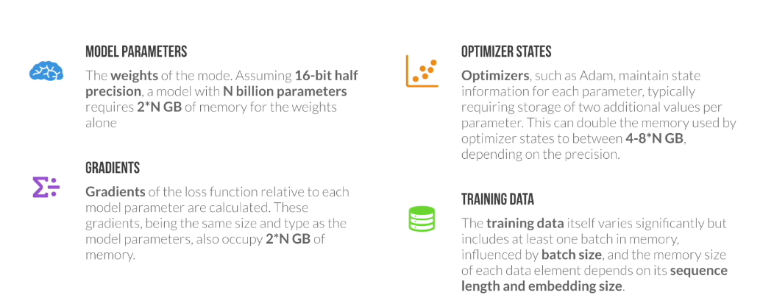
Memory Usage During Training

Slide 66
LLM Training Details - More Recent Models & Considerations
Model (Version/Size) | Est. Data Size (Tokens) | Context Size (Max Tokens) | Est. GPUs / Compute | Est. Training Time | Est. Electricity / Carbon Footprint | Est. Training Cost
GPT-3 (Base models like Davinci) | ~500 Billion - 1 Trillion (incl. C4, Wikipedia, Books, etc.) | 2,048 (later models up to 4,096) | ~10,000 V100 GPUs (for original run) / ~3.6M A100-equivalent hours (PaLM 540B reference) | ~34 days (using 1,024 A100s, research estimate) - Several months (actual, unconfirmed) | ~1,287 MWh (training) / ~552 tons CO₂eq (Patterson et al.) | $4.6M - $12M+ (compute, various estimates)
Llama 2 (All sizes) | 2 Trillion | 4,096 | Reported 6,000 GPU-months (A100-80GB equivalent for the family) / 1.7M+ GPU hours for 70B | Jan 2023 - July 2023 (overall project, specific model run time shorter within this) | 3.3M kWh (entire project) / 539 tons CO₂eq (training, 100% offset by Meta) | Significant (part of Meta's AI investment)
BLOOM (176B) | 366 Billion (1.6 TB) | 2,048 | 384 A100 GPUs | ~3.5 - 4 months | ~433 MWh (training) / ~25-55 tons CO₂eq (trained in France, low-carbon energy) | ~$2M - $5M (compute, public estimates)

Slide 67
LLM Training Details - More Recent Models & Considerations
Model (Version/Size) | Est. Data Size (Tokens) | Context Size (Max Tokens) | Est. GPUs / Compute | Est. Training Time | Est. Electricity / Carbon Footprint | Est. Training Cost
GPT-4 | Not officially disclosed (speculated >> GPT-3, likely multi-trillion) | 8,192 (GPT-4-8k) & 32,768 (GPT-4-32k); GPT-4 Turbo: 128,000 | Not officially disclosed (speculated tens of thousands of A100s/H100s) | ~5-6 months (speculative estimates) | Not disclosed (Expected to be significantly higher than GPT-3; estimates range from 20,000-78,000 MWh & thousands of tons CO₂eq for comparable efforts) | Est. >$60M - $100M+ (compute, speculative)
Llama 3 (Instruct models) | >15 Trillion (for the Llama 3 family) | 8,192 (some reports suggest up to 128k for future/experimental versions) | Significant clusters of H100s (e.g., Meta mentioned two 24k H100 clusters) | ~3 days (8B), ~17 days (70B), ~97 days (est. for 400B+ on 16k H100s) | Llama 3.1 405B est. ~11 GWh. Carbon footprint not yet fully disclosed, but Meta aims for net-zero operations. | Very High (part of Meta's large AI infrastructure investment)
Gemini 1.0 (Pro/Ultra) | Not officially disclosed (multimodal, likely vast & diverse datasets) | 32,768 (Gemini 1.0 Pro); Gemini 1.5 Pro: 1 Million (up to 10M experimental) | Trained on Google's TPU v4 and v5e pods (thousands to tens of thousands of TPUs) | Not publicly disclosed (likely months) | Not disclosed. Google emphasizes efficiency & use of renewable energy. Gemini 1.0 was reported to be more efficient than some predecessors. | Very High (part of Google DeepMind's core AI efforts)

Slide 68
Discussion / Q&A
What are the biggest challenges in training even larger and more capable LLMs?
How can we mitigate biases in LLM training data and subsequent models?
What future advancements in LLM training do you foresee?

Slide 69
Fine-Tuning Large Language Models (LLMs)

Slide 70
What is Fine-Tuning?
Pre-training Phase
Trained on large corpus using Masked Language Modeling (MLM) and Next Sentence Prediction (NSP)
Fine-Tuning Phase
Fine-tuning is the process of continuing the training of a pretrained LLM on a smaller, task-specific dataset.
The objective is to specialize the model for a particular use case or domain.
Why Fine Tune LLMs?
Improve performance on specific tasks.
Inject domain-specific knowledge (legal, medical, financial, etc.).
Adapt to company-specific language or tone.
Reduce inference cost by limiting model size and scope.
Use Cases of BERT Fine-Tuning
Customer Support Chatbots (trained on company FAQs).
Legal Document Analysis.
Scientific Paper Summarization.
Code Assistants for specific frameworks.
Sentiment classification for product reviews.

Slide 71
Typical LLM Fine Tuning Workflow
Choose a Pre-trained Model
Pick a base model from Hugging Face (e.g., distilbert-base-uncased for classification or gpt2 for text generation).
2. Prepare Your Dataset
Format your data appropriately. Common formats:
For classification: CSV with text and label columns.
For generation: Text file or JSON with prompt and completion.
3. Tokenize the Data
Convert text into tokens the model understands using a tokenizer.
4. Define Training Arguments
Set training parameters like learning rate, batch size, and number of epochs.
5. Train the Model
Use a trainer to fine-tune the model on your dataset.
6. Evaluate & Save
Check performance and save the model for future use.
7. Share (Optional):
Push your fine-tuned model back to the Model Hub.
Create a demo in Hugging Face Spaces.

